Slide 1

Sauder school of business Capstone project
Cem Sinan Ozturk, Tyler Roberts, Ted Thompson, Duong Vu

Slide 2
Presentation Outline
Problem Statement
The Data
Final Data Product
Data Science Technique
Timeline

Slide 3

PROBLEM STATEMENT
Sauder School of Business with large database from U.S. Securities and Exchange Commission fillings.
2 possible problems:
Classification of firm survival
Predicting firm performance.

Slide 4
THE DATA
U.S. Securities and Exchange Commision
Annual firm disclosure text data
645 features contain information from financial statements on a yearly and quarterly basis.
Center for Research in security Prices (CRSP)
Daily frequency financial data relating to stock prices
Compustat Data
Time range from January 1995 to March 2018
Time range from January 1995 to December 2017
More than 14,000 of those companies have multiple (>3) filings in the same period.

Slide 5
FINAL PRODUCT
1
A data pipeline making our analysis reproducible
2
A set of features extracted from the text data
3
A written report documenting our findings throughout the project

Slide 6
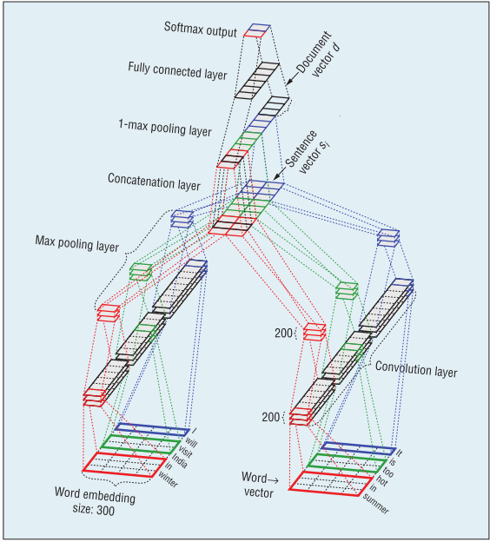
PROPOSED DATA SCIENCE TECHNIQUES
Feature Selection
Natural Language Processing
Classification/ Regression

Slide 7
TIMELINE
Milestone 1:
April 25th – May 2nd
Milestone 2: May 2nd – May 9th
Milestone 3: May 9th - May 18th
Milestone 4: May 18th - May 26th
Milestone 5: May 26th - June 4th

Slide 8

Cảm ơn

